Slide 1
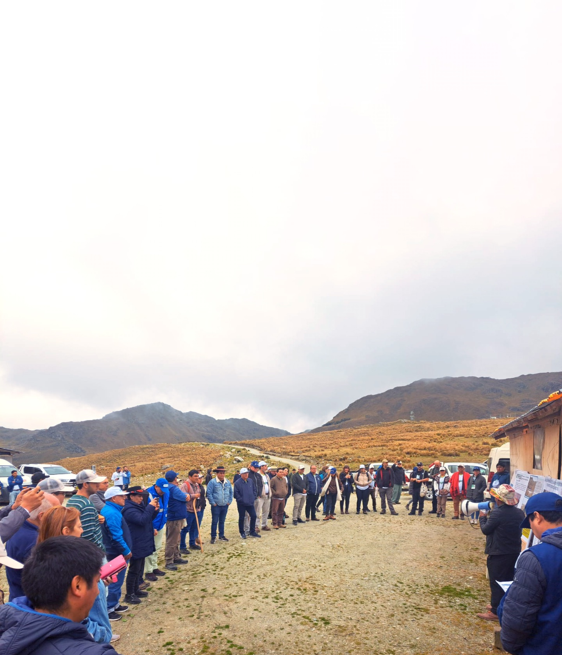
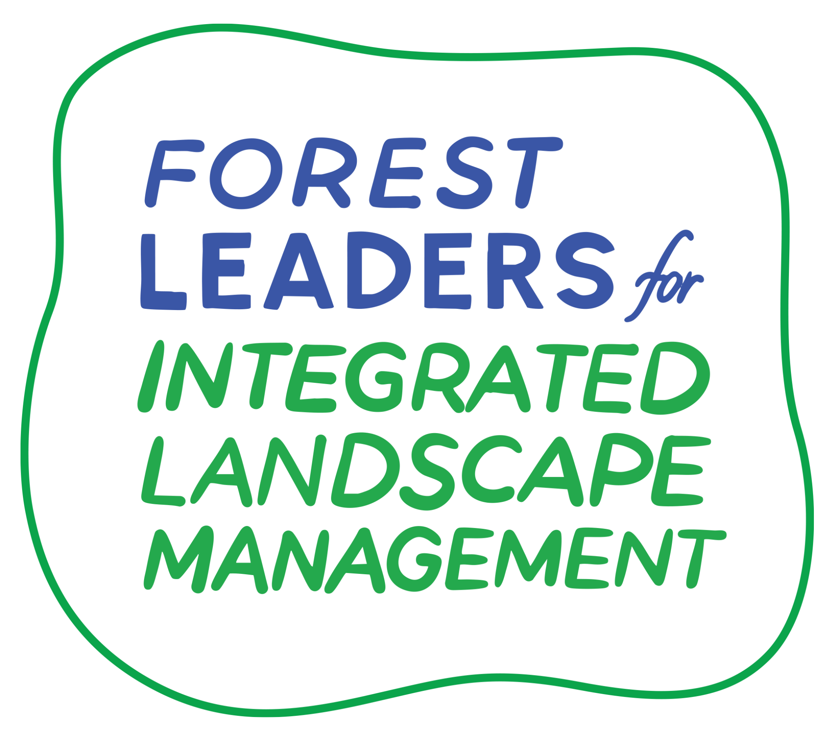



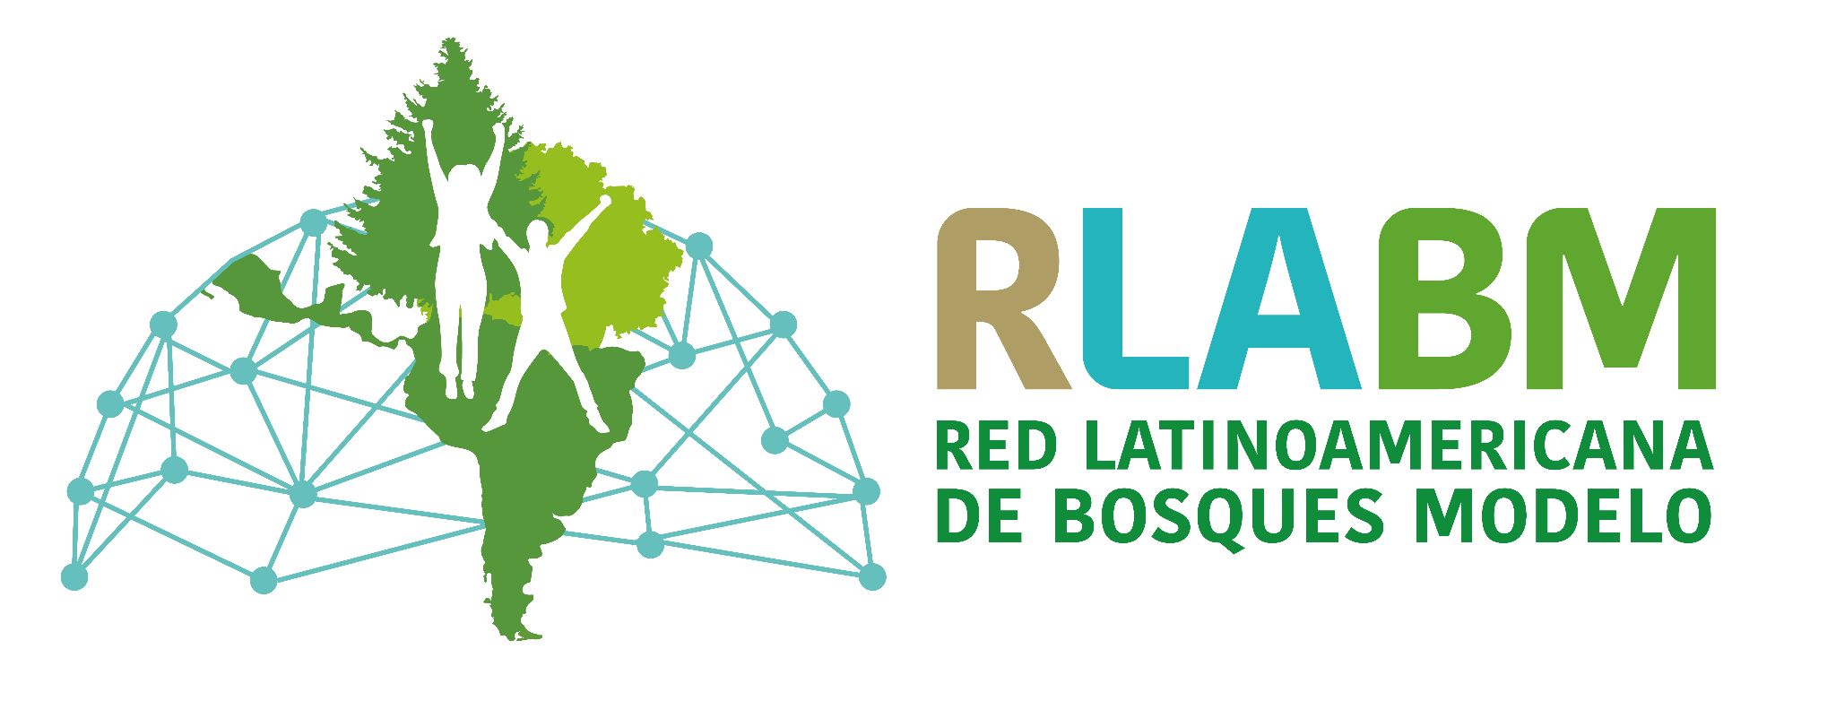
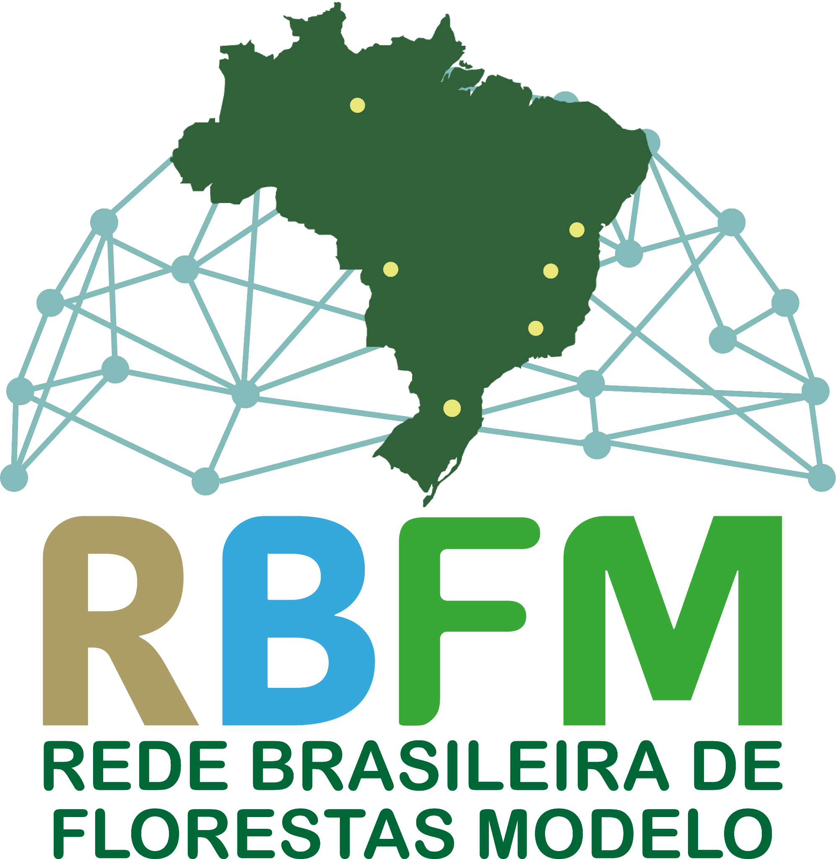

Strategic Communications
for Integrated Landscape Management
Key concepts and guidance for
practitioners

Slide 2
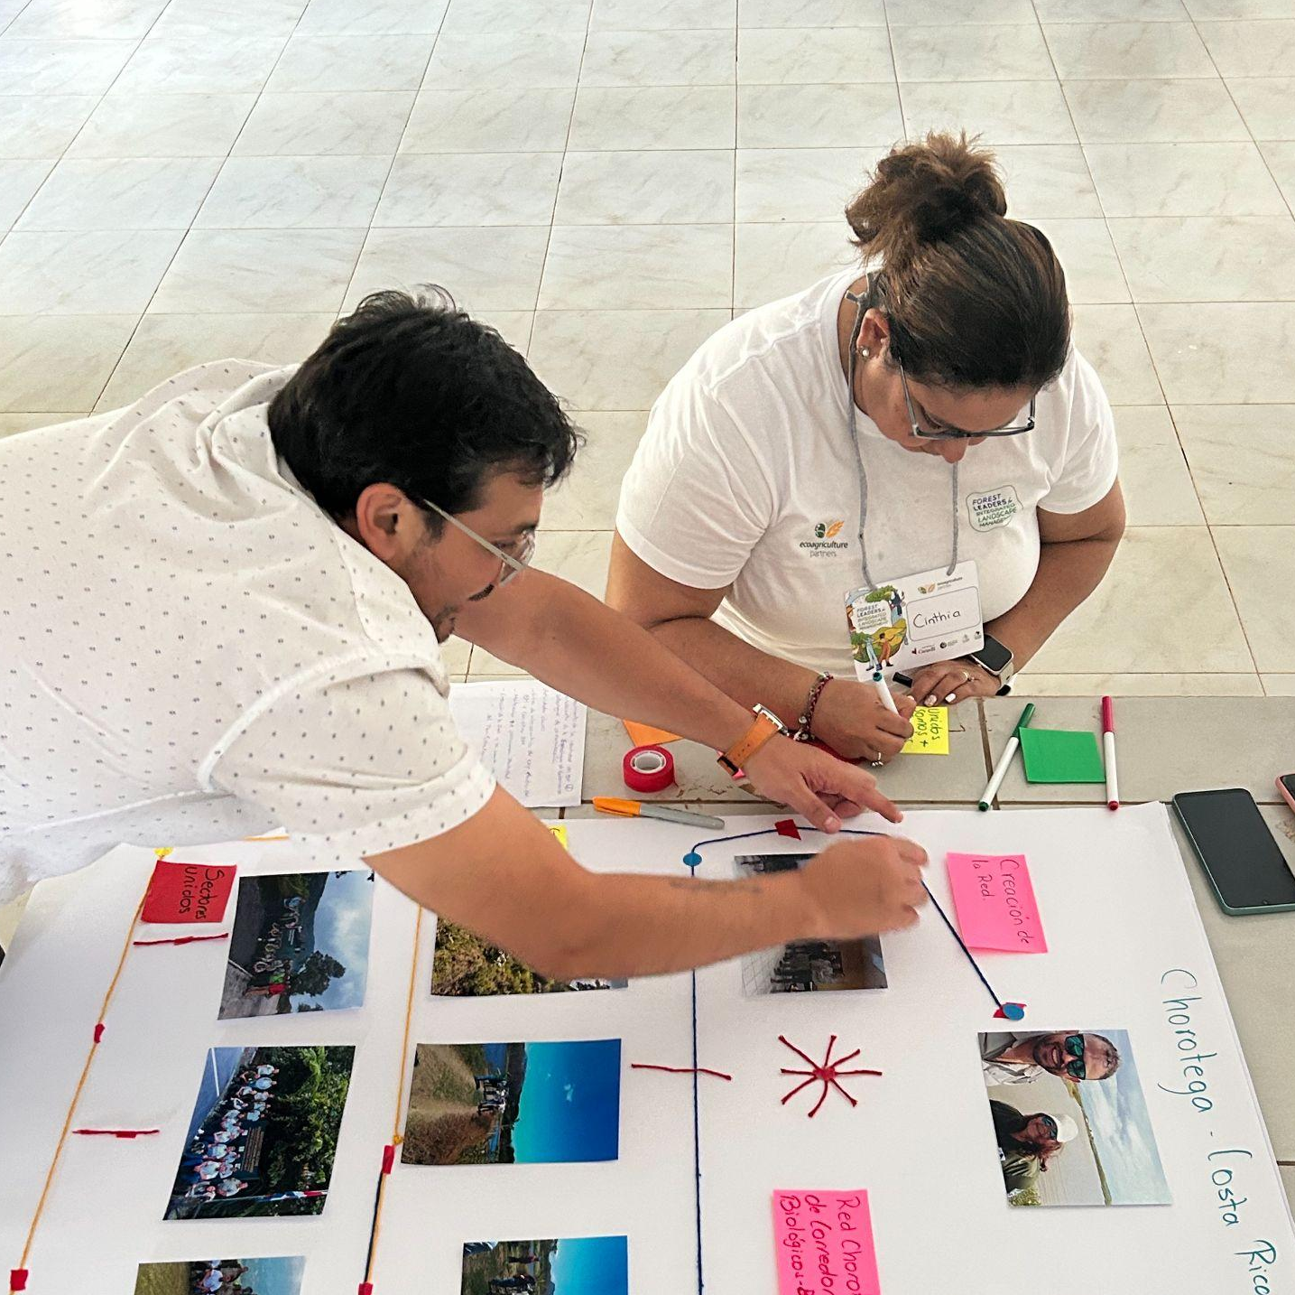
Purpose
This learning module aims to:
Provide facilitators and landscape actors with knowledge and tools to co-design communication strategies within Integrated Landscape Management (ILM);
Define a systematic approach that enables landscape initiatives to share, receive, and act on key information to promote coherence, clarity, and collaboration among actors;
Ensure that communication strategies recognize and respond to the diversity of landscape audiences and actors;
Provide guidelines for internal and external communication, facilitating stronger relationships and better management outcomes.
Contents
1. Introduction
2. Communication as a river that nourishes the landscape
3. Relevance of a communication strategy for ILM
4. Designing the communication strategy
5. From strategy to action
6. Support tool: Communication Canvas
7. References and additional resources
8. Ideas for a learning session

Slide 3
1
Introduction
ILM promotes a collaborative approach to the sustainable management of territories where different ecosystems and social actors converge and interact.
Given the social nature of ILM, communication is an essential competency, not only as a dissemination tool but as a strategic component for bringing together diverse visions of the landscape, building trust, and facilitating collective transformation processes. Without effective communication, the collaboration required for ILM becomes difficult to achieve.
A communication strategy can be defined as a planned approach for conveying specific information to defined audiences in order to achieve an established objective. When well planned, it makes it possible to define what information is shared, with whom, and for what purpose, aligning all landscape actors - local communities, authorities, businesses, NGOs, and others - with the landscape’s shared objectives.
In landscape initiatives, designing a communication strategy from this perspective ensures that diverse voices - including those historically underrepresented - are meaningfully heard. It also promotes consistency and alignment of messages, ensuring clarity, reducing misunderstandings, and fostering collaboration.
A communication strategy within ILM should:
Identify and address communication problems that may hinder joint work, including unhealthy communication patterns associated with power relations, privilege, or prejudice.
Help define and understand roles and responsibilities that facilitate internal coordination of the landscape partnership.
Recognize and adapt to the needs of diverse audiences and actors, promoting a more inclusive approach.
Establish clear guidelines for internal and external communication, ensuring that all actors are informed, understand the objectives, and contribute to making the benefits of the landscape initiative visible.
Improve implementation of actions and projects through strategic communication that strengthens relationships and optimizes collaborative results.

Slide 4
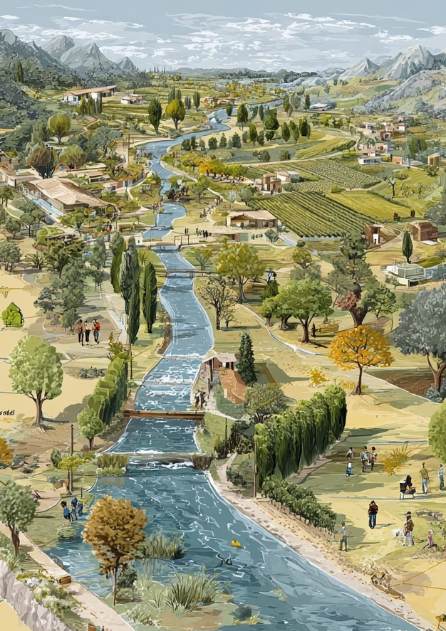
2
Communication as a River that Nourishes the Landscape
Communication in ILM can be compared to a river flowing through a watershed and across a territory. Just as a river shapes the landscape, connects ecosystems, and distributes life, communication connects people, visions, and ideas, shaping collaborative processes across the territory.
Just as we need to understand where water comes from, how it moves, where we want to take it, and who benefits, we also need to understand the flow of information and know what messages we want to convey, who sends them, who they are intended for, and what impact we want to generate.
This “communication river” has two main currents. The first is visible and on the surface: external communication, directed toward communities or the general public, potential key partners, institutions, or the media. The second is a deeper and less visible current: internal communication, which flows within the landscape partnership and enables coordination, decision-making, and cohesion. Both currents are essential. If one fails, the flow weakens, and collaboration stagnates. But if both flow with clarity and purpose, the landscape is strengthened, and joint action becomes possible.
A key element of this flowing river of communication is cultivating relationships. Just as ecosystems along a river depend on water, effective communication strategies thrive on the strength and depth of relationships built over time. These relationships, fostered through continuous and meaningful interaction, become the core of the communication process, influencing both the path of the message and its impact.
In collaborative landscape management, a communication strategy is the river that sustains life. Without it, landscapes can become depleted, life can stagnate, and disconnections can emerge, obstructing collaboration. With a well-nourished communication river, landscapes are revitalized, life thrives, and everything is interconnected.
This metaphor reflects landscapes as dynamic socio-ecological systems in which communication - especially its relational dimension - is central. Every conversation, interaction, and shared experience becomes a tributary that feeds the broader narrative and sustains collaboration among landscape actors.

Slide 5

External communication (the surface current)
External communication is the most visible part of our communication river, similar to surface currents. It represents the messages, narratives, and information we share with broader audiences. Just as the surface of a river can reflect the sky or surrounding landscapes, external communication reflects the objectives, values, and public image of the landscape initiative.
External communication includes:
Engaging broader audiences: potential landscape partnership members, media, residents of the territory, authorities, landscape funders, etc., through channels such as social media, press releases, and community events. The objective is to establish and maintain positive relationships with key external actors.
Public relations: managing the public image of the landscape initiative through strategic messages and media interactions. This includes creating narratives aligned with the values, vision, and objectives promoted by the landscape initiative.
Building trust: consistently practicing coherence and maintaining transparency in actions and communications. Trust is established by demonstrating reliability, competence, and integrity in all interactions.
The main goal of external communication is to generate interest, mobilize support, and make the landscape vision defined by the landscape partnership known externally. Addressing diverse expectations and ensuring that messages are consistent and resonate, while avoiding misinterpretation or misinformation, are major challenges.
These challenges also create opportunities to strengthen the initiative’s image and visibility, contribute positively to dialogue across sectors and communities, and position the landscape partnership as a thought leader and trusted reference in the territory.

Slide 6

Internal communication (the underground current)
Below the surface, although less visible, deeper currents drive the river’s real force, giving it movement and direction. Internal communication represents dialogue, feedback, coordination, and information exchange within the landscape partnership. Like underground currents transporting nutrients, internal communication nourishes the team with knowledge, clarity, and cohesion, ensuring that all members are aligned and move in harmony.
Internal communication includes:
Coordination: regular meetings of the landscape partnership and communication team, periodic updates, collaborative platforms, and instant messaging channels (WhatsApp, Telegram, etc.) to synchronize activities and share information.
Role clarity: clearly defining each member’s responsibilities and contribution to the objectives of the landscape initiative.
Fostering a sense of belonging: promoting a collaborative culture through participatory spaces such as open meetings, reflection sessions, and learning exchanges. These practices strengthen shared identity, reinforce commitment to the common landscape vision and objectives, and consolidate trust among members.
Its purpose is to ensure that all members of the landscape partnership share the same information, landscape vision and objectives. This way, when that information is communicated externally, the partnership conveys a consistent message, helping to prevent mistrust and misunderstandings.
For this reason, the communication strategy must balance both flows. Just as a poorly managed river can cause a landscape to dry out, poorly managed communication can weaken trust and collaboration. In practice, this means coordinating internal messages before communicating them externally.
Recognizing the complementarity and differences between internal and external communication is crucial. While internal communication focuses on alignment and coherence within the landscape partnership, external communication involves conveying these internal values and objectives to outside audiences in a way that is engaging and relevant to each external stakeholder. Balancing these aspects is key to a comprehensive and effective communication strategy.

Slide 7
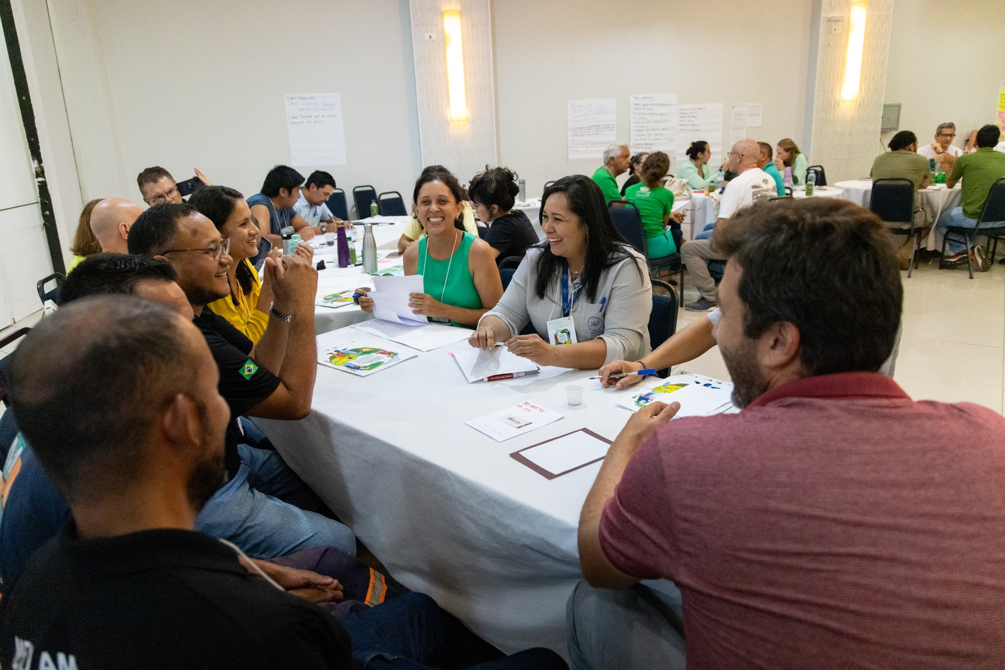
3
Relevance of a Communication Strategy for ILM
Before planning and implementation, it is important to understand why a communication strategy is relevant - that is, its importance and suitability for achieving the objectives of the landscape partnership and initiative.
In practice, this means connecting landscape goals and the specific portfolio of actions and projects with the priorities of each local actor. An aligned strategy facilitates mutual understanding and motivates action, ensuring that every communication activity has a clear purpose rather than becoming empty noise.
For example, a well-designed strategy links the objective of conserving a river with the interests of local fishers and farmers. By communicating benefits for water and economic security, it encourages participation in conservation activities. In this way, the strategy helps landscape actors feel connected, involved, and motivated to contribute to landscape objectives.
To assess the relevance of your communication strategy, ask: Why is a communication strategy needed? What specific objectives should it achieve? Who does it benefit? How does it align with landscape goals? These questions establish the foundation and make the strategy useful for the partnership and shared landscape objectives.

Slide 8
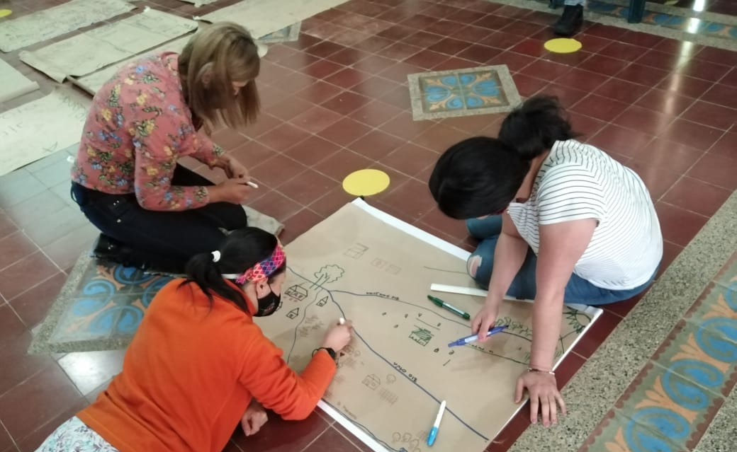
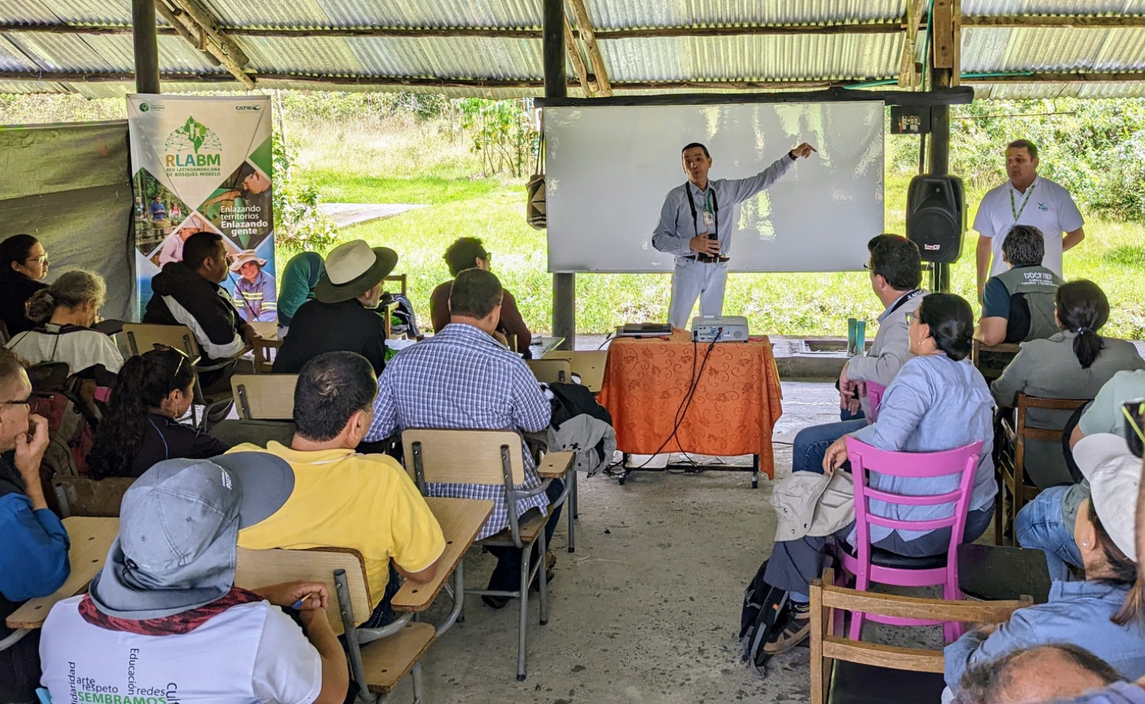
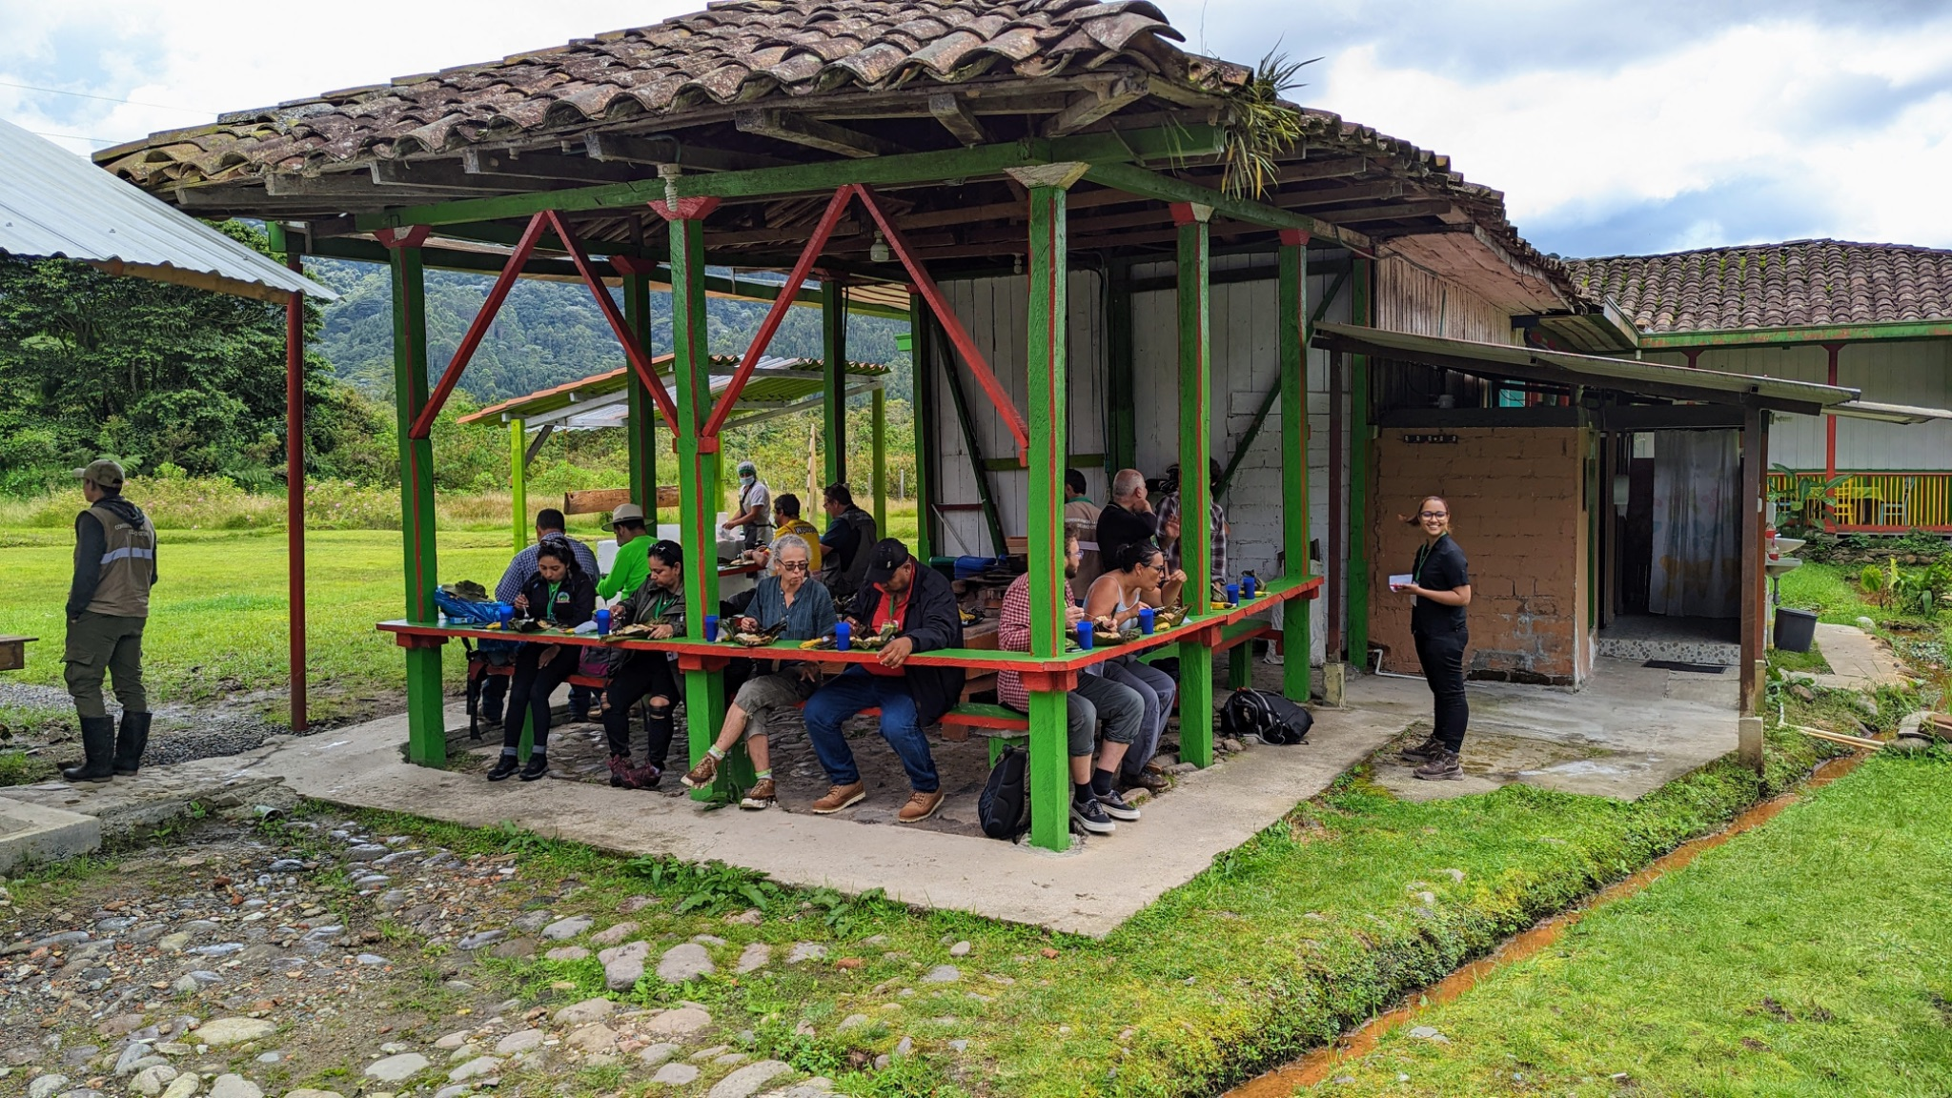
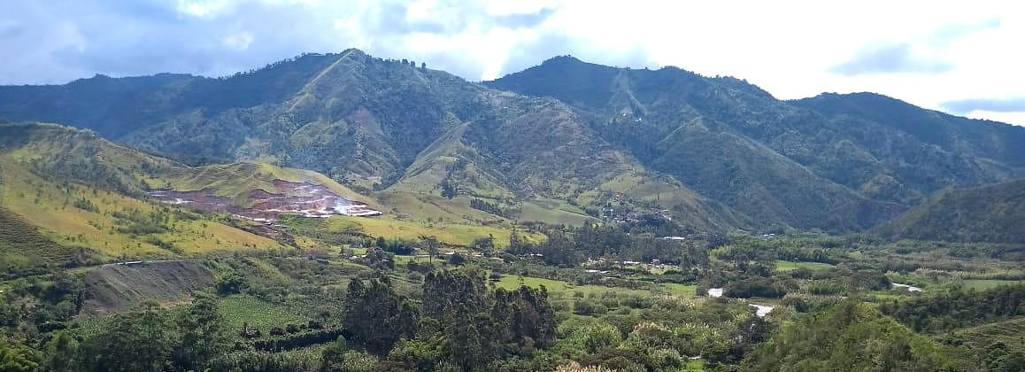
Illustrative example
“Risaralda Model Forest” landscape
The Risaralda Model Forest landscape in Dosquebradas, Colombia, illustrates the relevance of a well-structured communication strategy and how it can mobilize a territory in defense of its landscape. Faced with the threat of a mining project, a strategic communication campaign combined signature collection with clear, culturally relevant, and emotionally powerful messages. The campaign placed the issue on the public agenda, made environmental and social risks visible, and influenced municipal political decisions.
Youth leadership was a key element, playing a leading role in shaping the message, using digital media, and mobilizing across the territory. The strategy also connected multiple actors - local communities, authorities, academia, media, and civil society organizations - around a common cause. This synergy strengthened a sense of belonging and demonstrated how communication can be a powerful channel for building governance and collective action in ILM.

Slide 9
4
Designing the Communication Strategy
Once the importance and suitability of a communication strategy in an ILM initiative have been established, the next step is to design it. This process includes several key steps or components: identifying audiences and messages, selecting channels and resources, incorporating key partners, defining a budget, and identifying success indicators.
As with the discussion of its relevance, designing the strategy is a participatory process that should be approached through co-creation and collective development. However, here we will first focus on defining each of its components.
Defining Communication Objectives
Before defining the target audiences and messages, it is essential to have a clear understanding of the communication objectives. These objectives guide the strategy and give purpose to communication activities by defining what the communication is intended to achieve.
A communication strategy is based on a planned approach to sharing information with specific audiences in order to achieve a particular objective. In this sense, communication objectives describe the change we want to bring about among these audiences—whether in terms of understanding, engagement, or action—and guide the development of messages, channels, and activities.
In the context of Integrated Landscape Management, communication objectives should be aligned with the objectives of the landscape initiative. This means connecting the goals of the landscape with the priorities, interests, and motivations of landscape stakeholders, facilitating their participation and contribution to collective processes.
Clearly defining these objectives helps ensure that communication goes beyond simply providing information, allowing each action to have a clear purpose and contribute effectively to collaboration and landscape outcomes. To guide this reflection, the landscape partnership can consider questions such as:
What do we want to achieve through communication at this point in time?
What do we want different audiences to understand, value, or do differently?
How can communication contribute to advancing the objectives of the landscape initiative?
What type of relationship do we want to strengthen with our audiences (inform, engage, mobilize, coordinate)?

Slide 10
Identifying Target Audiences and Key Messages
In the context of ILM, target audiences are the different landscape stakeholders—and, in some cases, relevant external stakeholders—to whom communication is directed. Because these processes involve multiple groups—such as rural communities, farmers, community leaders, local authorities, NGOs, businesses, and the media—it is essential to clearly define whom we want to reach (our audience) and what we want to communicate to them (key messages).
A useful first step is to conduct a landscape stakeholder mapping exercise to identify who will be involved in the activities of the landscape partnership, who can influence its outcomes, and who needs information or motivation to participate actively. The following questions can help guide this process:
Who will be affected by or involved in the activities carried out by the landscape partnership?
Who could support or hinder the achievement of the landscape’s objectives?
Who needs to change their attitudes or behaviors for the landscape vision and actions to become a reality?
Each group has different interests, concerns, ways of communicating, and preferred communication channels. Once these have been identified, key messages should be developed and tailored to each one. A key message is the central idea that we want an audience to understand and remember, so it should be framed in terms that are relevant to them. When developing messages, it is useful to consider:
What matters to this audience?
How do the actions and projects relate to their needs or aspirations?
Table 1 provides some examples of audience types and key messages that reflect the interests and concerns of different landscape stakeholders.
It is essential that messages be clear, concise, and positive, avoiding complex or technical language. They should emphasize benefits, opportunities, or solutions rather than problems in order to encourage participation. And although messages should be tailored to each audience, they should all be consistent with one another and aligned with the landscape vision and objectives—as if they were different chapters of the same story, rather than different stories.
A useful exercise for identifying a key message is to summarize the essence of the change we seek in the landscape in a single sentence—this becomes the central “big idea”—and then develop specific “sub-messages” for each audience based on that big idea.

Slide 11
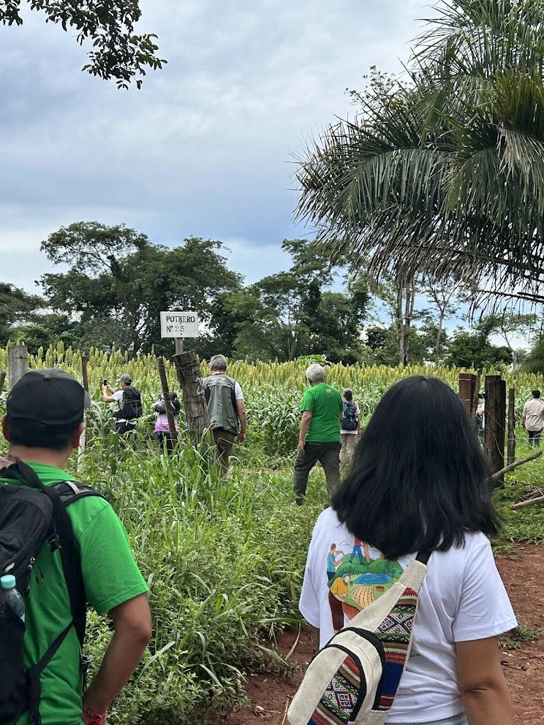
Table 1
Target audience | Key message
Local communities: family farming households, Indigenous Peoples, residents of the area | “A healthy forest ensures water for our crops and families; together we can restore it and improve our quality of life.”
Youth community leaders | “You can be a guardian of the landscape: learning and launching sustainable initiatives.”
Local governments and other authorities | “Actions carried out within the landscape initiative contribute to national reforestation and sustainable rural development goals while generating local employment.”
Funders | “Our landscape management model is working and can be replicated elsewhere; your support will have a multiplier effect in the region.”

Slide 12
Available channels and resources
Once key messages (the what) and target audiences (the who) have been defined, decide how to reach them effectively by considering communication channels and the resources available to the landscape partnership.
Communication channels: Communication channels are the means through which messages are transmitted. They range from digital to traditional, and the choice depends on where each target audience is most active and receptive. Digital channels (websites, email, social media, mobile applications) may be more appropriate for broad and younger audiences; traditional media (community radio, local television, print media, flyers) may be more suitable for populations with less internet access. In addition to these, in-person or community approaches - workshops, assemblies, neighborhood meetings, local fairs, and field visits - can be especially appropriate for direct participation and dialogue.
When choosing channels, we should ask ourselves: Through which media is this audience most likely to receive and pay attention to the message? Which channels are within our reach given the available resources? For example, there is little point in distributing viral videos online if almost no one in the area has a good internet connection, or printing brochures if people are not accustomed to reading that type of material. We need to adapt to the local reality. On the other hand, a combination of channels is often most effective. For example, the same message to the community could be announced on local radio (broad reach), then explored in greater depth in person at a community assembly (direct interaction), and reinforced with an illustrated handout that people can take with them.
Resources: Resources are the inputs or capacities needed to communicate and include human, technological and financial resources. It is therefore useful to take an inventory of available resources. First, consider the tools and media available to us: Do we have access to reliable internet? Do we have community loudspeakers, a local printing service, a photo/video camera or projectors? Which digital platforms do we know how to use (Facebook, WhatsApp, YouTube)? Second, assess human resources and the capacities of landscape partnership members or the team responsible for communication: Is someone skilled in graphic design? Who writes well? Who has the charisma to speak in public or on the radio, write content or take photographs?
In this way, we can define the mix of channels to use for each target audience and message, ensuring that they are accessible and effective in the landscape context. We do not need to be present in every medium, only in those that genuinely connect our initiative with the right people. It is also useful to schedule the appropriate frequency and timing of communication for each channel (for example, how many social media posts per month or during which phase of a project key workshops will be held) in order to distribute the effort over time.

Slide 13
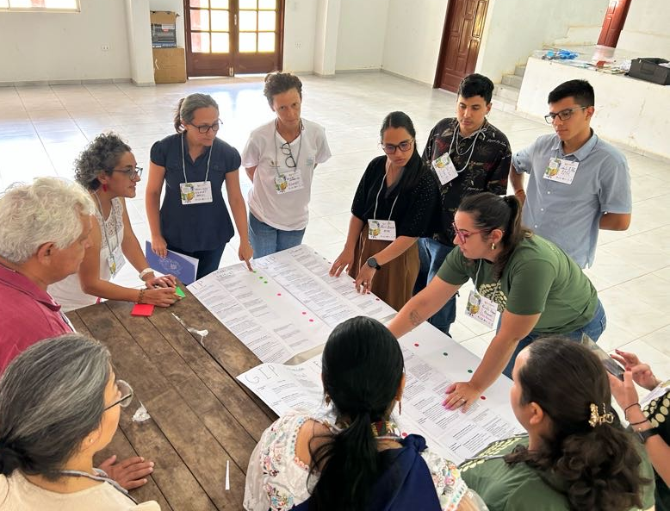
Key partners
Within a landscape partnership, communication does not have to fall solely on the team; identifying key partners can greatly increase the reach and impact of the strategy. These are individuals or organizations that can help disseminate messages, lend legitimacy, and expand outreach to audiences that may otherwise be difficult to reach. For example, local media outlets (radio, newspapers, television channels) can share news about the activities of the landscape initiative; organizations with similar or complementary objectives (environmental NGOs, farmers’ associations, universities) can co-organize events or share information through their networks; community leaders or local opinion leaders can influence their communities by communicating messages as trusted voices; and even influential figures on social media (bloggers, activists) can help amplify the message.
Therefore, just as key landscape stakeholders are identified, when designing the communication strategy it is useful to map potential communication partners: Are there any networks or forums of local organizations? Which community leaders are respected in the area? Are there educational or government institutions interested in the same issues? What does this partner gain from communicating our message? Once identified, these partners can be engaged early on to share objectives and explore synergies.

Slide 14
Activities and budget
All strategic planning must be realistic about available financial resources. It is therefore essential to estimate a communication budget, even if it is only a basic one, for the planned activities. Developing this budget involves listing the planned communication activities and assigning an approximate cost to each. These activities may include awareness-raising campaigns, training workshops, and the creation of multimedia content. Each activity should be carefully planned to ensure that it is aligned with the overall objectives of the strategy. For example, if one objective is to increase environmental awareness within the local community, activities could include educational workshops in schools or communities and social media campaigns highlighting the importance of the local landscape. In addition to the activities themselves, expenses for necessary tools or inputs should also be considered (graphic design, social media management, transportation, audiovisual equipment rental, etc.).
An effective communication strategy requires adequate allocation of financial resources, distributed in a way that ensures priorities are covered. If the budget is limited, the strategy will need to be creative and prioritize accordingly. For example, it may focus on low-cost, high-reach communication activities (such as social media or partnerships with community radio stations) before investing in more expensive activities. In-kind support can also be sought from members of the landscape partnership (for example, an organization could provide the venue or refreshments for a launch event). Budgeting helps prevent unexpected costs and allows communication activities to be implemented smoothly, while adapting our ambitions to the resources actually available.
Indicators of success
From the beginning of the design process, it is important to define how we will measure the impact and success of the communication strategy. These indicators will help monitor progress and adjust activities based on results. Ideally, both quantitative and qualitative indicators should be established to provide a comprehensive picture. The number of people reached by our messages (event attendance, radio listeners, social media followers or impressions), audience engagement (comments and shares, registrations for activities), the participation rate in community initiatives following a campaign against intentionally set fires, and the number of media appearances over a given period are some examples of quantitative metrics.
Qualitative indicators, on the other hand, capture changes in perceptions, attitudes, and relationships, which are equally relevant but less tangible. These might include audience feedback (satisfaction surveys or opinion polls on perceptions of landscape management), testimonials or success stories, and the level of trust or understanding generated among stakeholders, among others.

Slide 15
Defining from the outset what “success” means in communication gives us a clear sense of direction. If we know what we are aiming for, for example, “greater involvement of women in restoration activities,” we can measure how many new women participate following communication activities targeted toward them. Or, if we want to “position forest conservation on the local agenda,” we could measure how often the topic is mentioned on local radio or in municipal forums. In short, indicators of success act as both a compass and a thermometer: they guide our actions toward the desired results while also showing us the progress being made, allowing us to learn and adapt the strategy to maximize its effectiveness.
The following table provides some examples of quantitative and qualitative indicators for communication in the context of ILM.
Quantitative indicators | Qualitative indicators
Reach and coverage: Number of copies of materials distributed Estimated listeners of a radio program (based on ratings or local surveys) Event attendance Social media followers Active participation: Number of people contributing ideas or feedback Number of local volunteers engaged through campaigns Internal communication practices: Number of coordination meetings held per month Percentage of the team reporting that they are well informed and understand the landscape initiative (measured through an internal survey) | Level of understanding of certain concepts: According to verbal responses or surveys. Level of trust: Measured through testimonials from local stakeholders. Improvements in cohesion and collective action: For example, community leaders report that they now work more closely with other sectors following dialogues facilitated through the landscape initiative’s projects.

Slide 16
5
From Strategy to Action
Having outlined the components of the communication strategy (audiences, messages, channels, etc.), the major challenge that remains is putting it into practice effectively.
Two activities are crucial for this goal: (a) co-creating the strategy with the stakeholders involved to ensure shared understanding and commitment, and (b) clearly defining the roles and competencies of the communication team responsible for implementing it. Without participation, the strategy may become disconnected from reality; without clear roles, it may remain a set of good intentions without being put into action.
Co-creation and Shared Understanding
In the context of ILM, a communication strategy is not developed from a single perspective, but through a participatory, collaborative, and inclusive process that actively involves different landscape stakeholders. Co-creation means developing the strategy collaboratively with key stakeholders so that everyone can contribute while also taking ownership of the plan. This applies both to the initial design of the strategy and to its ongoing adaptation. In this way, the strategy can better reflect the diversity of perspectives, knowledge, and priorities within the landscape, creating a holistic approach that reflects and responds to the unique concerns and needs of the local context.
Through workshops, community meetings, focus groups, or other participatory approaches, valuable input can be gathered on key messages, priority target audiences, and the most effective communication channels. This process also extends from building an understanding of the importance of communication to maintaining continuous feedback mechanisms that help adjust and strengthen the strategy over time. Another tool that supports the collective development of an ILM communication strategy is the Communication Canvas, which can be discussed and completed collaboratively.
Co-creation also extends to the development of communication materials and activities. For example, the Mosaico Model Forest landscape involved local youth in writing the script and editing a video about the history of the landscape initiative, helping ensure that the language and story resonated with the local culture (while also turning the youth into enthusiastic ambassadors). Actions like this ensure that communication is not a message imposed from the outside, but something built from within the landscape itself.
The benefits of co-creation are significant. First, it improves the relevance of communication because it incorporates local knowledge, perceptions, and the realities of the target audience, helping to avoid cultural or strategic missteps. Second, it creates a sense of ownership: stakeholders feel that “this strategy is ours; we created it together,” making them more likely to support and implement it. Third, it strengthens local capacities: by participating in the design and implementation of communication activities, people can develop communication skills, discover their own voice, become more confident expressing themselves, and apply what they have learned to other initiatives.

Slide 17
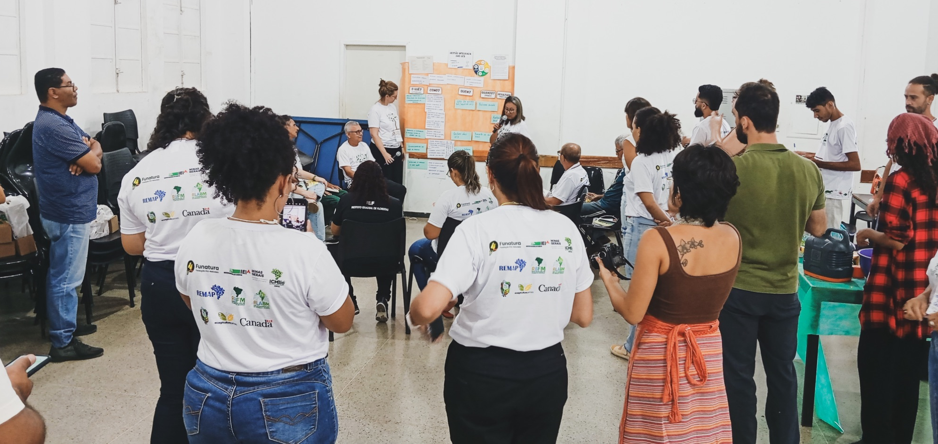
In summary, co-creating the communication strategy with landscape stakeholders allows communication itself to become an exercise in integration. Rather than being a technically sound plan that is disconnected from the people it is intended to serve, it becomes a feasible plan that is supported and enriched by those who are ultimately both its intended audiences and its implementers.
Key Elements for Co-creating a Communication Strategy
Define clear objectives
Align the strategy with the landscape vision and its long-term objectives.
Understand our target audience
Identify their needs, expectations, and communication preferences, and tailor messages and channels to each type of audience.
Develop relevant messages
Adapt the language and approach to each audience, incorporating their values and ways of expressing themselves.
Select appropriate channels
Use digital, in-person, or community-based channels according to what works best for each audience.
Encourage participation
Create opportunities for listening, proposing ideas, and validation, from the design stage through evaluation.
Implement with flexibility
Remain open to change, feedback, and continuous learning, evaluating and adjusting the strategy as needed.

Slide 18
Roles and Competencies of the Communication Team
Having a solid strategy is only the beginning; putting it into practice requires people to take on clear responsibilities. Even with limited resources, it is essential to define who does what when it comes to communication. Many landscape initiatives do not have a “formal” communication team, but it is still possible—and necessary—to distribute roles among the existing team or involve volunteers or partners in this work. Clearly defined roles help prevent communication tasks from being left undone or, conversely, everyone trying to do everything in an uncoordinated way.
Assigning communication tasks and responsibilities should take into account each team member’s skills, knowledge, and experience, as well as the competencies required for different roles, to ensure that responsibilities are well coordinated and carried out effectively. A well-structured team, in which members’ roles are aligned with their competencies, not only improves efficiency but also strengthens team morale: when each person works in an area where they are strong, they feel more confident, errors are minimized, decision-making is streamlined, and the overall quality of communication improves.
The following competencies can be useful within the communication team. They do not all need to be found in a single person; what matters is recognizing which capacities are available and how they can complement one another:
Technical Competencies | Interpersonal Competencies
Strategic planning Content creation and editing Photography, video production, and editing Media relations Digital communication and social media Visual design and brand management Public speaking and event coordination Analysis and monitoring | Assertive communication Empathy and cultural sensitivity Conflict resolution Adaptability to change Collaborative leadership
In practice, these competencies translate into concrete actions such as developing and managing a social media calendar, designing educational materials for community workshops, coordinating press conferences, or analyzing engagement metrics to refine communication tactics.

Slide 19
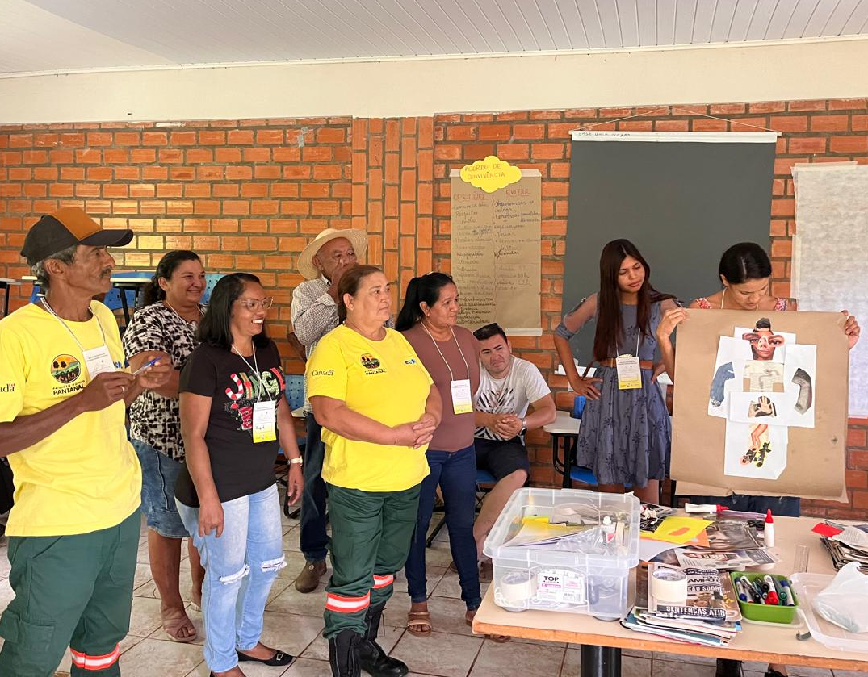
Alongside these competencies, there are also some specific tasks that are often essential for developing and implementing a communication strategy in landscapes:
Develop communication plans adapted to the resources of the landscape partnership
Write and edit content based on key messages
Design newsletters, posters, and other visual materials
Maintain a library of photographs and videos
Manage social media and websites
Organize events or community meetings
Carry out public relations activities
Share results and lessons learned with all audiences
Maintain active and clear internal communication channels
Manage crisis communication
Promote the active participation of landscape stakeholders
Assigning these tasks based on each person’s skills helps the team function as an integrated system, in line with the collaborative and adaptive approach promoted by ILM.

Slide 20
6
Support Tool:
Communication Canvas
When designing a communication strategy, the many different components (objectives, messages, channels, etc.) can feel overwhelming. To organize ideas clearly and encourage collective creativity and participation, it is useful to draw on visual tools, such as the Communication Canvas proposed here.
Aligned with the participatory principle of ILM, using this tool—for example, as part of a workshop—can generate rich discussions among landscape stakeholders: participants discuss which messages are appropriate, which partners could help, and in doing so not only strengthen the strategy but also build a shared understanding. Everyone leaves the workshop knowing what the communication approach will be, what role they will play, and having agreed on the approach. This template makes it possible to see all the key components of the communication strategy at a glance on a single page. In the context of ILM, a Communication Canvas will typically include the following sections:
Communication objectives: These should connect with the vision and objectives of the landscape initiative. It is advisable to have only a few (2 to 4 main objectives) and to make them specific. These objectives will guide the other components of the Canvas.
Target audiences: Key stakeholders we want to reach. Key characteristics or needs of each group can be noted alongside the name of each audience.
Key messages: The central ideas we want to communicate, which can be formulated either broadly or for each target audience.
Channels: The media and formats that will be used to convey messages to the different audiences. These can be listed in order of importance or linked to each audience, since each audience may have one or two channels that are particularly well suited to reaching them.
Communication activities: Although these are related to the channels, this section should specify concrete actions and communication products. Detailing them helps with planning a timeline and assigning responsibilities.
Resources (and budget): Key resources needed to implement the activities and channels identified above, including financial, human, and material/technological resources. Having these visible on the Canvas helps ensure that logistical constraints and strengths are taken into account during planning.
Indicators of success: The main metrics that will be used to evaluate communication.
Key partners: Individuals and organizations that are strategic to communication, identified by name. This allows us to know who to coordinate with for each action during implementation.

Slide 21
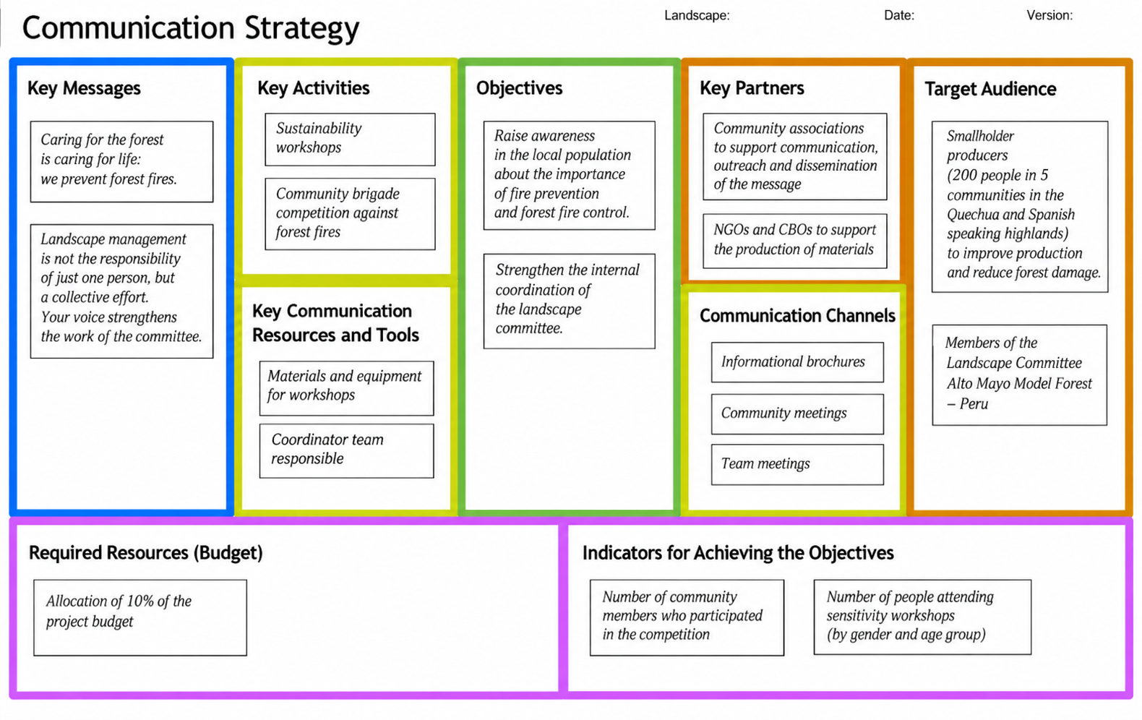
The following example illustrates how the Communication Canvas can be applied to the Abancay Model Forest landscape in Peru.
Facilitation Tip
To complete the Canvas collaboratively, it is recommended to print it in a large format (for example, A0) and assign a color to each section (objectives in yellow, target audiences in red, etc.). Through a facilitated brainstorming session, participants can use cards or sticky notes to write down one idea per card (an objective, a target audience, a message, etc.). Only the cards containing ideas that have been validated and agreed upon by all participants should remain visible on the Canvas.
As in the example provided, many versions of Communication Canvases are available online and can be downloaded free of charge.

Slide 22
7
References and Additional Resources
1000 Landscapes for 1 Billion People (1000L). Advocacy in Landscapes. Part of the Learning Modules for Integrated Landscape Management (ILM).
https://landscapes.global/capacity-strengthening-for-landscape-leadership-learning-modules-for-ilm/
1000 Landscapes for 1 Billion People (1000L). A Practical Guide to Integrated Landscape Management. https://www.globallandscapesforum.org/publication/a-practical-guide-to-integrated-landscape-management/
1000 Landscapes for 1 Billion People (1000L). Integrated Landscape Management Tool Guide. https://landscapes.global/wp-content/uploads/2022/10/ILM_Tool_Guide.pdf
EUROPARC Federation. Communication Skills Toolkit. https://www.europarc.org/library/project-archive/communication-skills/toolkit/
International Model Forest Network (IMFN) (2019). Communications Toolkit – Chapter 6. https://imfn.net/wp-content/uploads/2019/03/Toolkit2019_Eng_FINAL_Chapter6.pdf
1000 Landscapes for 1 Billion People (1000L). Landscape Narratives. Part of the Learning Modules for Integrated Landscape Management (ILM). https://landscapes.global/capacity-strengthening-for-landscape-leadership-learning-modules-for-ilm/
Miner, Cynthia L.; Sands, Yasmeen; Pierre, Hugo (eds.) (2014). Communicating Forest Science. IUFRO Communications & Public Relations Working Party and IUFRO Special Programme for Development of Capacities (IUFRO-SPDC). Vienna, Austria. 185 p.

Slide 23
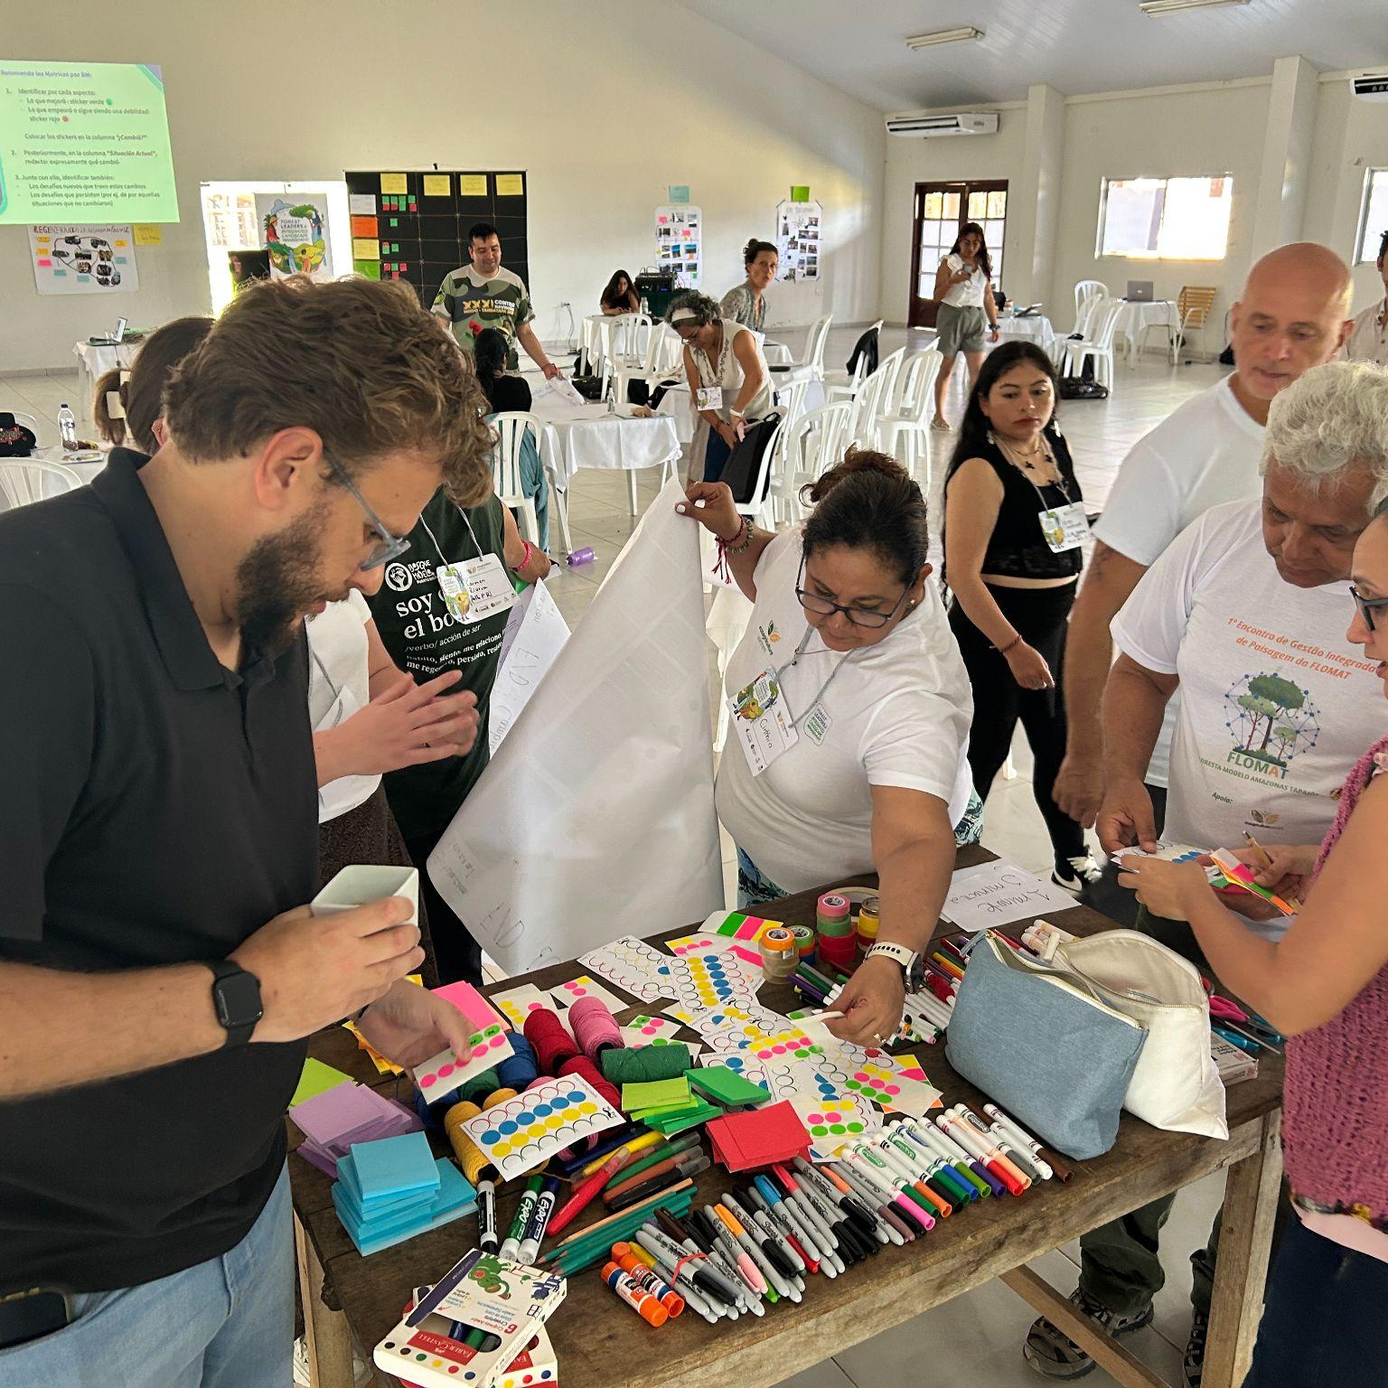
8
Ideas for a Learning Session
This facilitation guide accompanies the Strategic Communication for Integrated Landscape Management module and provides practical guidance for conducting interactive and participatory sessions. Its purpose is to strengthen the capacities of landscape stakeholders to understand and apply strategic communication as a key tool for governance through the participatory development of a Communication Canvas.
It includes a sample workshop agenda; however, facilitators can adapt the timing, activities, and sequence according to the specific context, participants, and cultural setting.
Expected Learning Outcomes
After this session, participants will be able to:
Recognize the strategic role of communication in ILM.
Identify communication objectives and the other key components of a communication strategy, applying them to their own context.
Collaboratively develop a draft Communication Canvas to guide concrete communication actions.

Slide 24
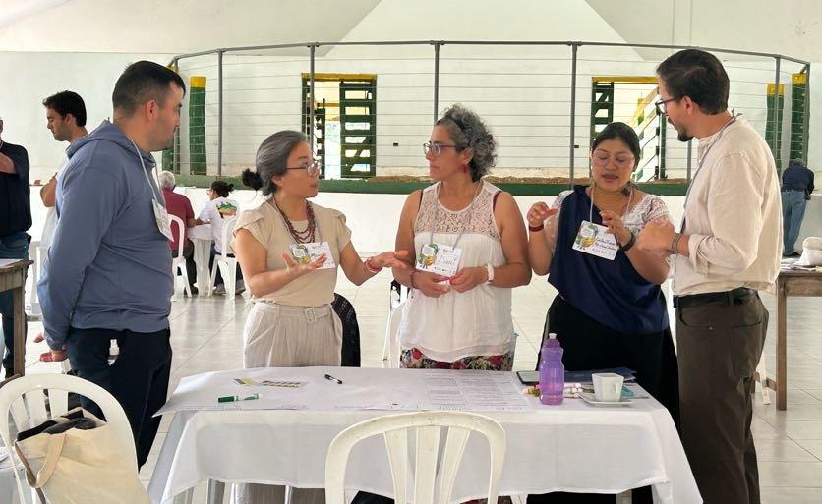
Strategic Communication Workshop for ILM
This workshop is designed for the landscape partnership and other key stakeholders in the landscape who contribute—or could contribute—to the governance and collective action process. It uses a participatory methodology that values both technical knowledge and local experience.
The workshop begins with reflection activities to explore how communication is already present in the landscape and how it influences coordination, trust, and decision-making. Building on these reflections, participants collectively develop an understanding of the fundamental concepts of strategic communication and its relevance to ILM.
The workshop then moves into a practical phase, in which participants define communication objectives and collaboratively develop a Communication Canvas with all its components: audiences, messages, channels, key partners, activities, resources, etc.
Finally, the workshop concludes with an exchange of proposals, lessons learned, and next steps for continuing to strengthen collaboration across the landscape.
The proposed workshop is designed to be delivered over six hours; however, it is recommended that the timing be adapted to the participants’ circumstances and availability, while avoiding making the session either too compressed or unnecessarily long.

Slide 25
Sample Workshop Agenda
Objective | Activity Description | Materials | Time
Introduce the workshop and the group | Activity 1: Introduction and Opening DESCRIPTION: Present the workshop objectives, agenda, ground rules, and facilitation team. Then, conduct an activity to help participants get to know one another and feel comfortable. Many options can be found online, such as the “web” activity, identifying with animals, or simply introducing themselves. |  | 15 min
Connect with our landscape’s communication experience | Activity 2: Recognizing Communication DESCRIPTION: Ask the group: In what spaces or situations does communication take place in the landscape? Who communicates with whom, and for what purpose? Record responses on flipchart paper and group them into two broad categories: Internal communication: among stakeholders in the landscape partnership or initiative (coordination, meetings, decisions, organization). External communication: with other stakeholders within or outside the landscape (local communities, authorities, media, funders, etc.). The plenary discussion can conclude with questions such as: Which of these types of communication do we use more? Which do we pay less attention to? What happens when one of them fails? FACILITATION TIPS: Ensure that everyone has an opportunity to speak and highlight the diversity of responses. Brainstorm as a group or have participants write ideas individually on cards (one idea per card). | Flipchart paper and individual cards | 30 min
Align communication concepts | Activity 3: What Is Communication? DESCRIPTION: Building on the previous exercise, encourage participants to identify what communication is, as well as what internal and external communication mean. After four or five contributions, the facilitator presents the final definitions to build a shared understanding. | Slides with definitions | 10 min
Reflect on the strategic importance of communication for collective action in ILM | Activity 4: Blind Drawing Activity DESCRIPTION: Randomly divide participants into pairs. Give one person in each pair a simple image and explain that they will need to give instructions to their partner. The other person must draw the image without seeing the original. Give each pair (or groups of pairs) different conditions for completing the task. For example: Group 1: Can only speak, but cannot ask questions. Group 2: Cannot speak and can only use gestures. Group 3: Can communicate freely. | Images, drawing paper, and colored markers | 45 min

Slide 26
Objective | Activity Description | Materials | Time
Reflect on the strategic importance of communication for collective action in ILM | Activity 4 (continued): Blind Drawing Activity At the end, participants compare their drawings and reflect on how they felt, the difficulties they encountered, what helped them achieve better results, etc. To conclude, connect the exercise to experiences in the landscape: What happens when landscape stakeholders do not share clear information? How does this affect coordination among organizations and sectors? What happens to trust when messages are confusing or contradictory? How does this affect the ability to act together in response to challenges in the landscape? Suggested key messages to reinforce: In ILM, communication is not just about sharing information: it is essential for building trust, coordinating actions, and sustaining collective action over time. Unclear or uncoordinated communication can create confusion, conflict, or inaction, weakening governance processes. | Images, drawing paper, colored markers, and slides with key messages | 45 min
Define what we want to achieve through communication (objectives) | Activity 5: Communication Objectives DESCRIPTION: Transition from the previous exercise to this new section: “If we want our ‘drawings’ (our actions in the landscape) to turn out better, simply communicating is not enough: we need to communicate with intention. That is strategic communication.” IN GROUPS, discuss: a) what we want to achieve through communication; b) what we want to change among stakeholders; and c) how we expect them to participate. Based on this discussion, each group develops 2 or 3 communication objectives. IN PLENARY: Groups share their objectives and agree on 2 to 4 communication objectives for the landscape initiative. FACILITATION TIP: Guide participants toward responses that reflect concrete changes. | Cards, pens or markers, flipchart paper, and guiding questions | 50 min

Slide 27
Objective | Activity Description | Materials | Time
Define the components of strategic communication | Activity 6: Building the Communication Canvas DESCRIPTION: Drawing on the information in the theoretical module, present the communication components and their definitions, using practical examples from the landscape. When discussing resources and tools, pay particular attention to human resources, their capacities, and their roles in the strategic communication process, and encourage participants to consider these when completing the Canvas. Once there is a shared understanding of the concepts, divide participants into groups and assign each group one of the agreed communication objectives. Each group should complete the communication components of the Canvas for its assigned objective. Use the following logical sequence to complete the Canvas, guided by these questions: 1) Audiences: Who do we need to engage to achieve this objective? 2) Messages: What do we need this audience to understand, value, or do differently? 3) Channels: What is the best way to reach this audience? 4) Key partners: Who can help us communicate this message more effectively or increase its impact? 5) Activities: What concrete actions will we take to communicate this message to this audience? 6) Resources, capacities, and tools: What people (and roles), skills, tools, or resources do we need to carry out these activities? 7) Indicators: How will we know whether our communication is achieving its objective? 8) Required resources: What financial resources do we need to implement these activities? | PPT with definitions of the communication components, Communication Canvases on flipchart paper, cards or sticky notes, and markers or pens | 70 min
Define the components of strategic communication | Activity 7: Canvas Fair DESCRIPTION: Conduct a cross-pollination exercise in which each group reviews the Canvases they did not work on and enriches them with new ideas by adding cards. At the same time, participants select one priority activity for each objective (each Canvas). In plenary, reach agreement on these priorities and the feasibility of implementing them. | Completed Communication Canvases, cards, and markers | 45 min
Move into action | Activity 8: Closing and Next Steps DESCRIPTION: Ask: What are we taking away from this experience? What should we now do as a partnership? What next steps can we take? Based on the final question, agree on concrete actions, responsible persons, and deadlines for implementation. These actions can then be monitored at a subsequent meeting. |  | 30 min

Slide 28

Acknowledgements
This learning module is part of an ongoing effort to promote practical learning and reflection on integrated approaches to sustainable landscape management. It is designed as a resource for landscape practitioners and leaders seeking to understand and implement communication strategies that support more effective and efficient Integrated Landscape Management (ILM). It can be used as a theoretical foundation for learning sessions or as a stand-alone resource.
This learning module is part of the Forest Leaders for Integrated Landscape Management project, which seeks to strengthen the capacities of landscape leaders to enhance the resilience of landscapes and Model Forests in Latin America by promoting alignment and collaborative, inclusive governance among multiple stakeholders within a landscape.
This project was developed with the support of Natural Resources Canada, in collaboration with the International Model Forest Network and the Latin American Model Forest Network. The content of this module also contributes to the broader efforts of the 1000 Landscapes for 1 Billion People initiative, of which we are a part, which brings together diverse organizations to develop learning resources on integrated landscape management.
Authors
Pilar Valbuena Pérez | Claudia Rojas Ríos | Réka Blakemore | Max Yamauchi Levy
Graphic Design: Dolores Cavanagh
EcoAgriculture Partners
EcoAgriculture Partners (EcoAg) is a global nonprofit organization advancing collaborative action so people and nature flourish. EcoAg helps local leaders, communities, governments, businesses, and funders envision, design and implement landscape approaches that build climate resilience, strengthen food systems, and sustain ecosystems and livelihoods. For more than 20 years, EcoAg has worked across Africa, the Americas, and Asia to strengthen leadership, foster inclusive governance, unlock catalytic financing, and build strategic partnerships that amplify impact.
Visit ecoagriculture.org

Slide 29



Latin American Model Forest Network
The Latin American Model Forest Network is a voluntary alliance of 32 Model Forest territories in 14 countries across Latin America, the Caribbean, and Spain, covering more than 38 million hectares. It promotes sustainable and inclusive development through participatory, landscape-scale governance, strengthening collaboration, knowledge exchange, and local capacities as part of the broader International Model Forest Network.
Visit bosquesmodelo.net
International Model Forest Network
The International Model Forest Network (IMFN) is a voluntary global community that promotes sustainable management of forest-based landscapes through a partnership-based Model Forest approach. Model Forests bring together diverse stakeholders — such as communities, governments, academia, and the private sector. The network fosters collaboration, knowledge sharing, and practical solutions to address environmental, social, and economic challenges at the landscape level.
Visit imfn.net
1000 Landscapes for 1 Billion People
1000 Landscapes for 1 Billion People (1000L) is a coalition of organizations united in a shared mission
to advance local landscape efforts to sustain and restore ecosystems, build rural prosperity, confront
climate change and contribute to the Sustainable Development Goals.1000L is building the infrastructure to help landscape partnerships connect and ally with one another, strengthen their capacities and leadership, access digital data and tools for greater impact, and mobilize financing to scale landscape investment.
Visit landscapes.global

